Slide 1
Data Science Tools and Techniques
to Turbo Charge Your Process Improvements

Slide 2
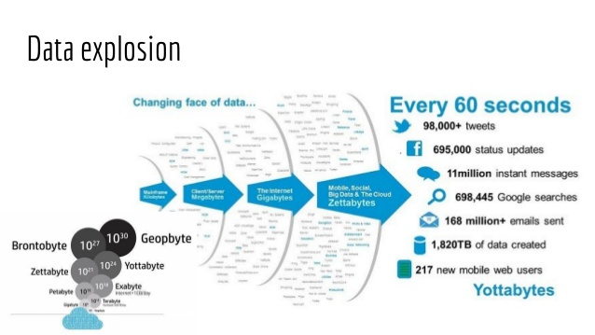
What’s all the hubbub?

Slide 3
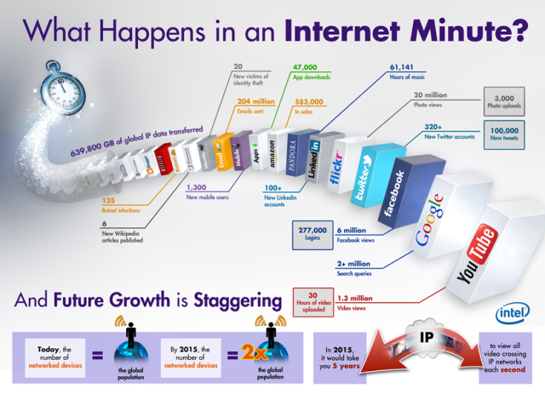
What’s all the hubbub?

Slide 4
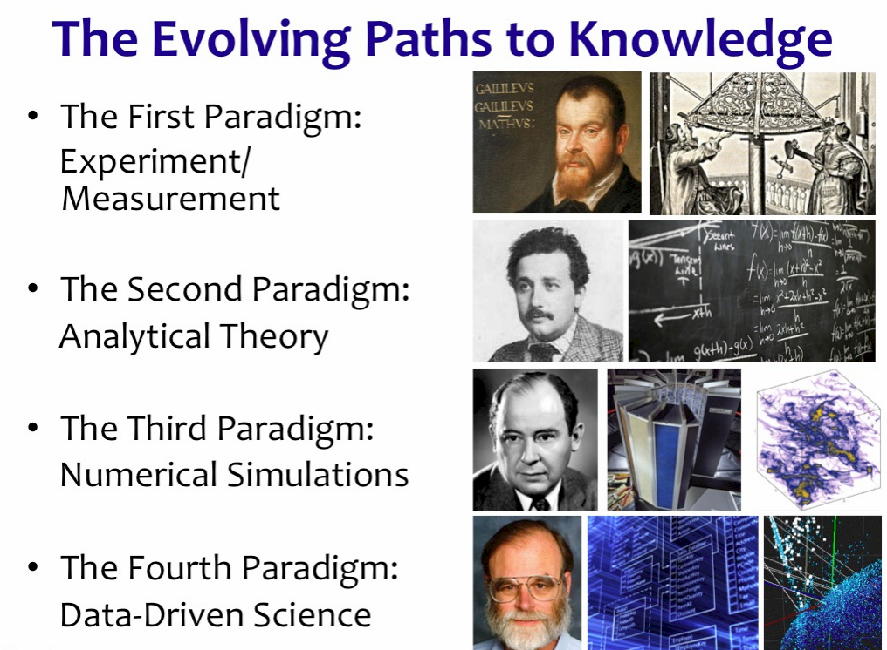
What’s all the hubbub?

Slide 5
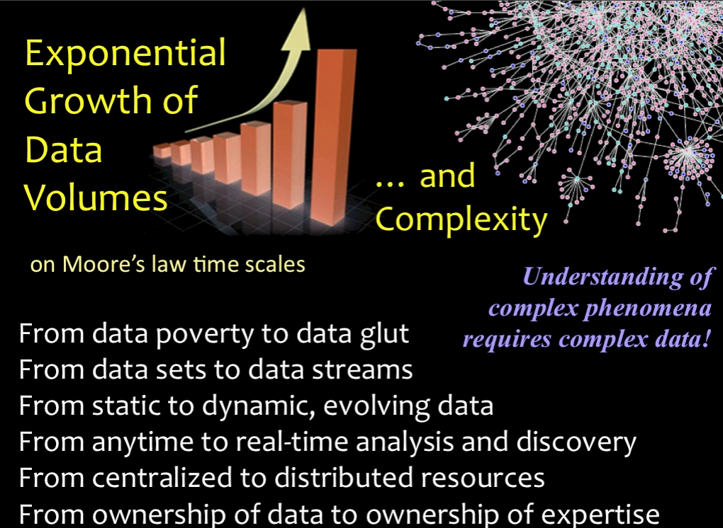
What’s all the hubbub?

Slide 6
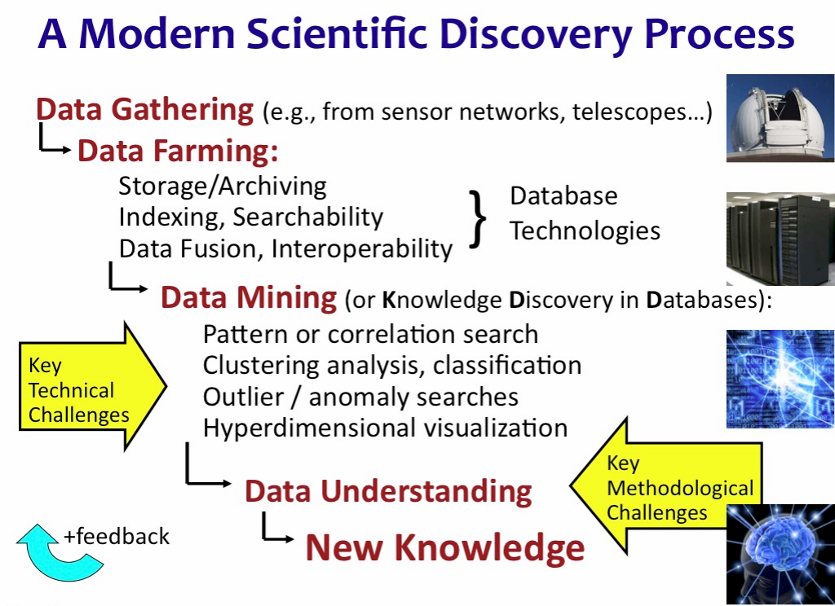
What’s all the hubbub?

Slide 7
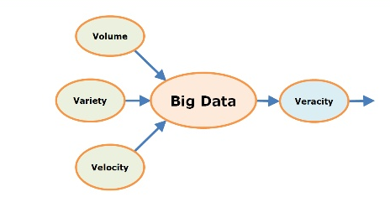
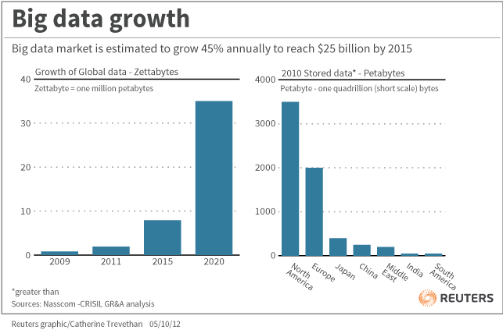
What’s all the hubbub?

Slide 8
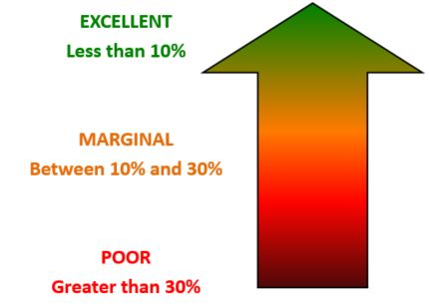
Isn’t it all just a big MSA?
Every project is a data project….
Data Quality
E.G. GDPR

Slide 9
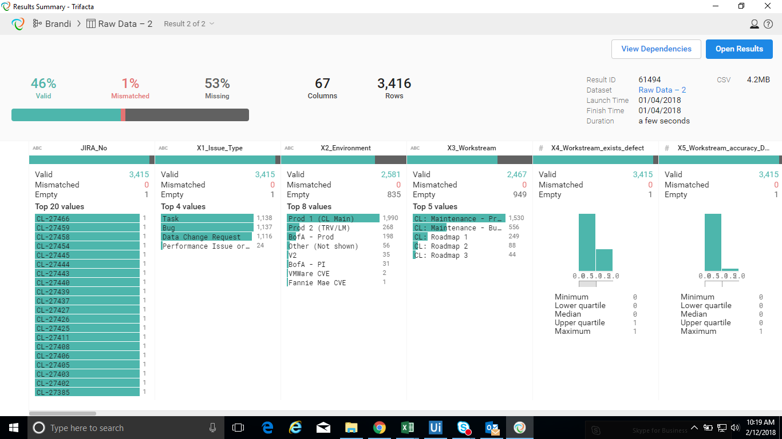
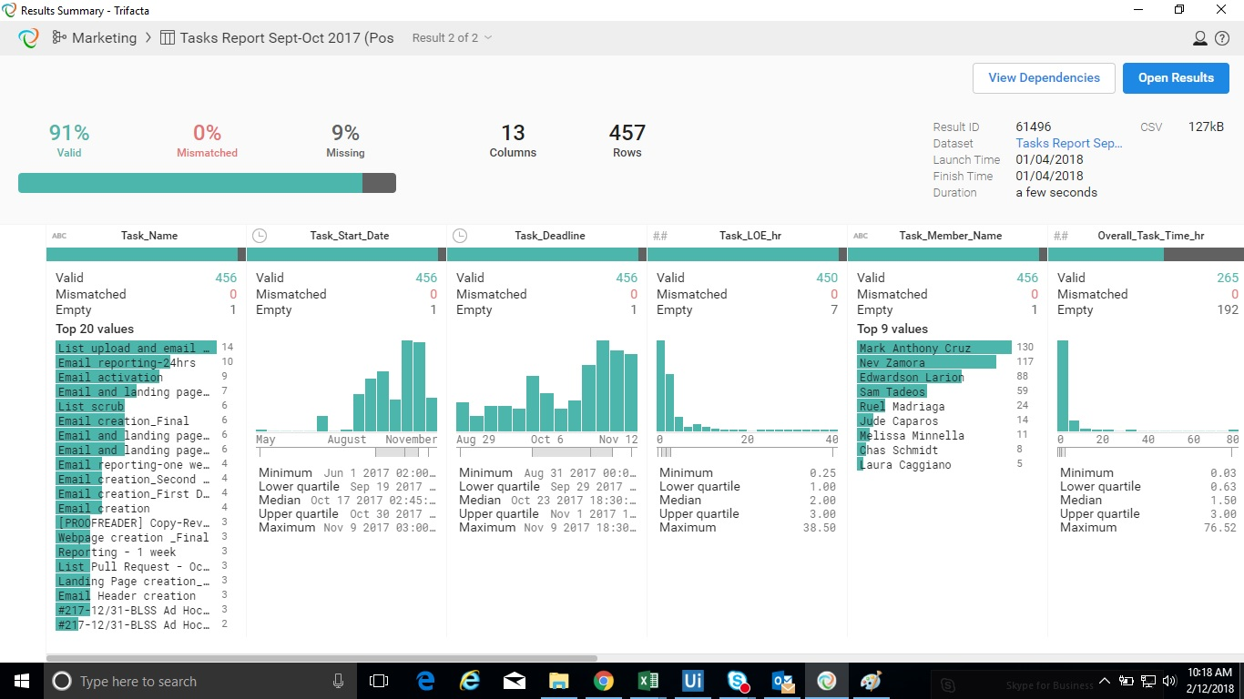
Isn’t it all just a big MSA?
Tool: Trifacta Wrangler
www.trifacta.com

Slide 10




Execution Engines
Rather than get wrapped around the axle about competing tools and techniques, I prefer to call these things “Execution Engines”:
Project/Program Management
Change Management
Lean
Six Sigma

Slide 11
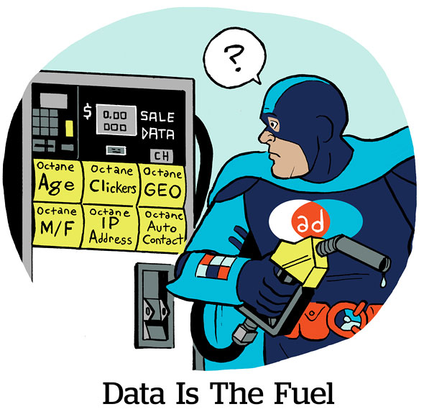
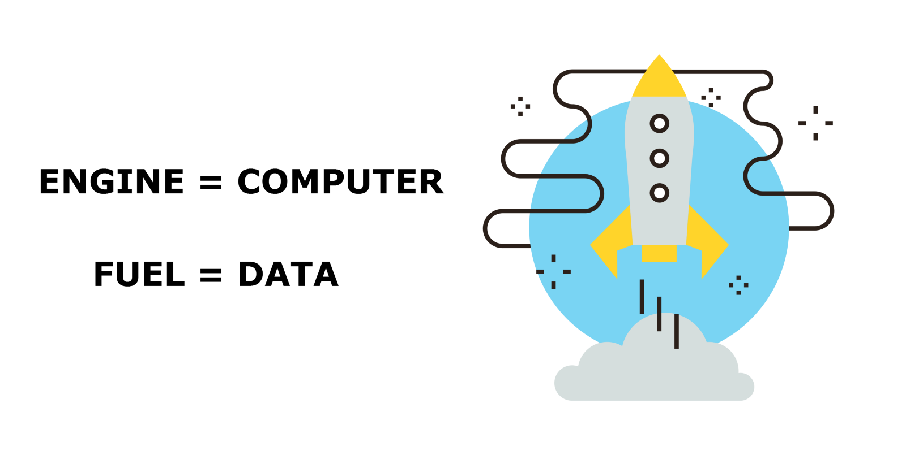
Execution Engines
If those “things” are the engines, the data is the fuel that runs through those engines.

Slide 12
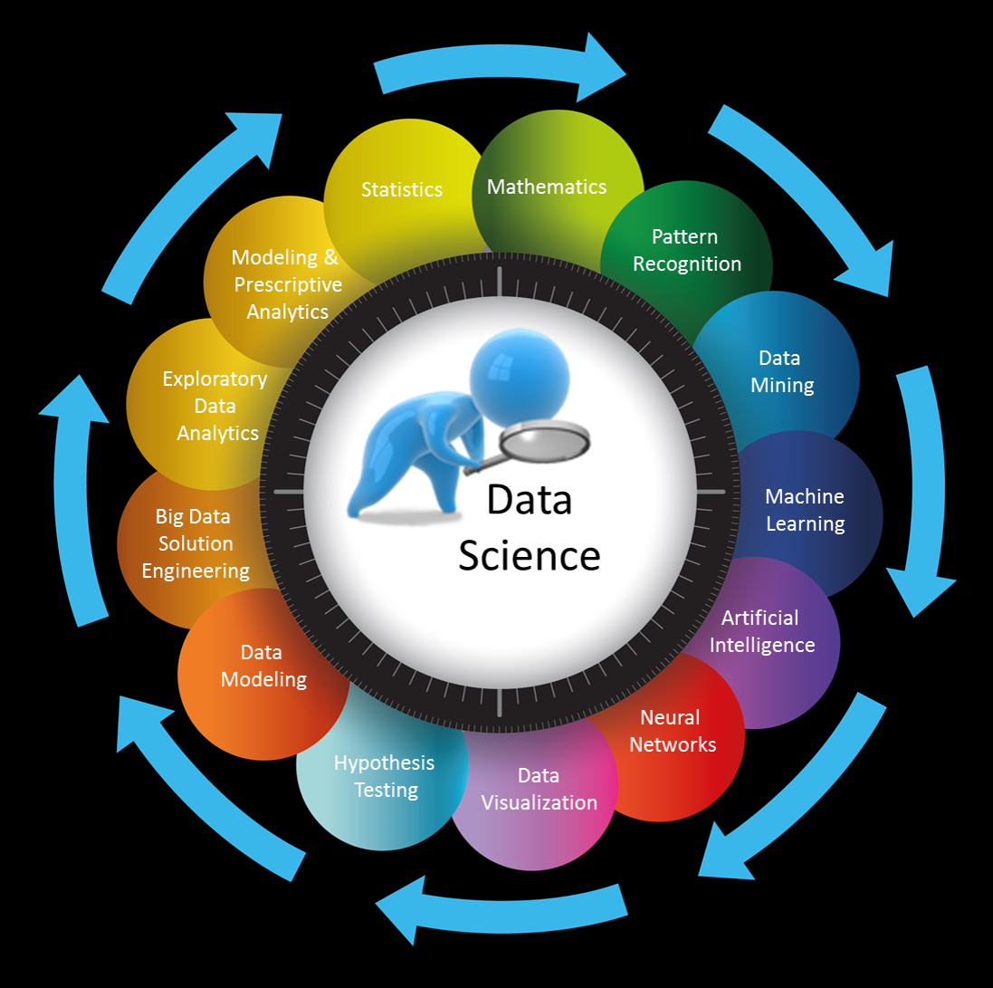
What do you mean “Data Science”?

Slide 13
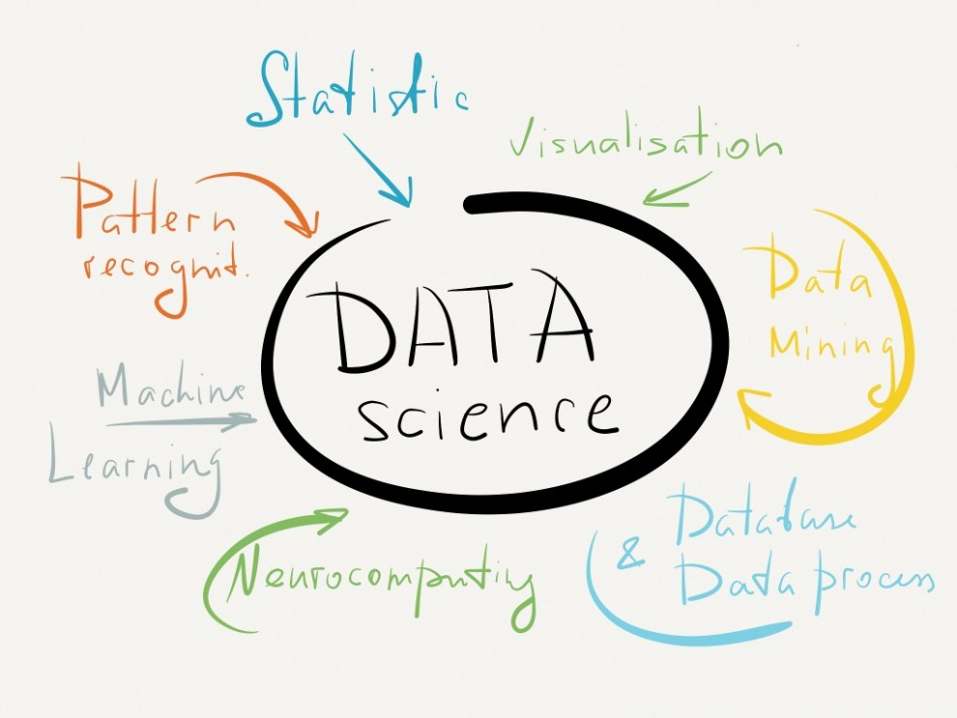
Let’s Lean it Out!

Slide 14
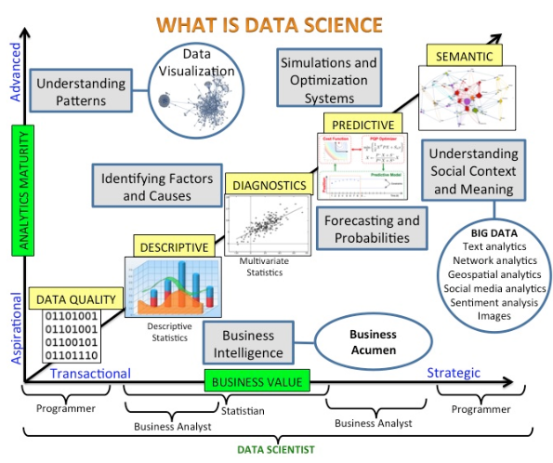
Sound a little familiar?

Slide 15
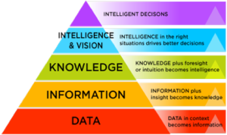
Data Science/Six Sigma Intersection

Slide 16
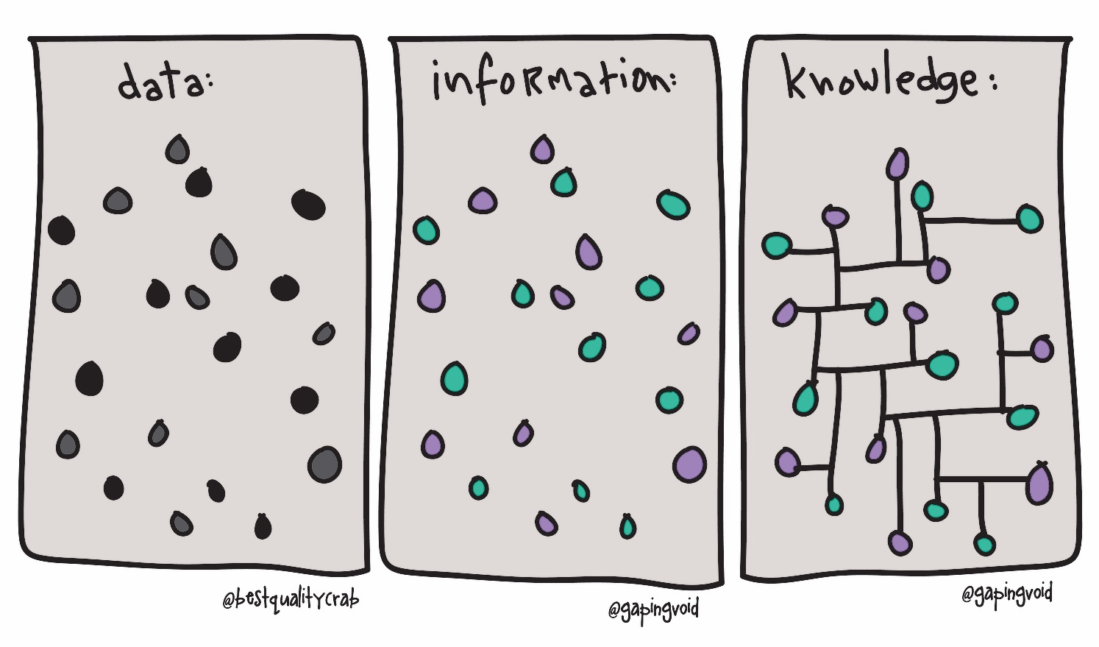
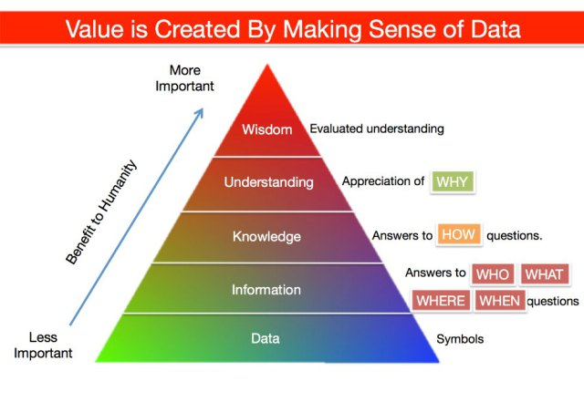

Data Science/Six Sigma Intersection

Slide 17
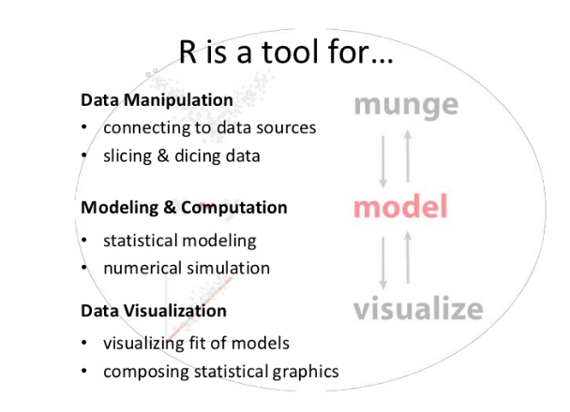
The Tools: R (yup the letter)
Start here:
https://cran.r-project.org/

Slide 18
Tour Time
Overgrown calculator
Numerical simulator
Statistical modeler

Slide 19
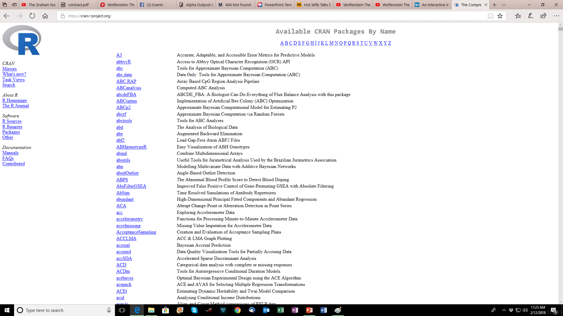
R Packages
This is page 1 of ~280 pages

Slide 20
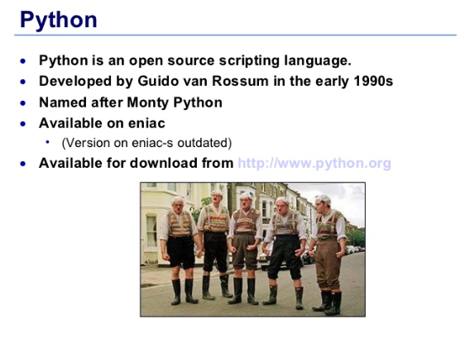
The Tools: Python (yup the snake)
Start here:
http://www.python.org

Slide 21
Tour Time
Little harder to install
True development language
Little harder to run
Less packages, but packages tend to have more functionality

Slide 22
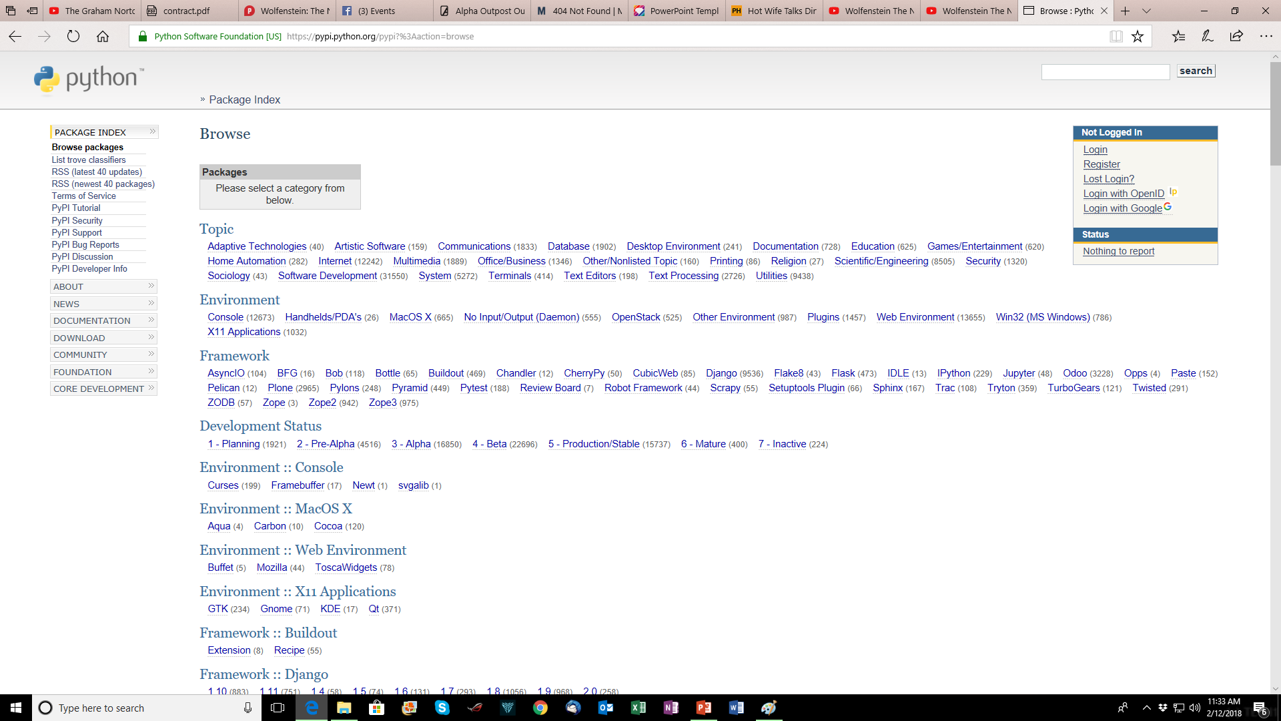
Python Packages

Slide 23
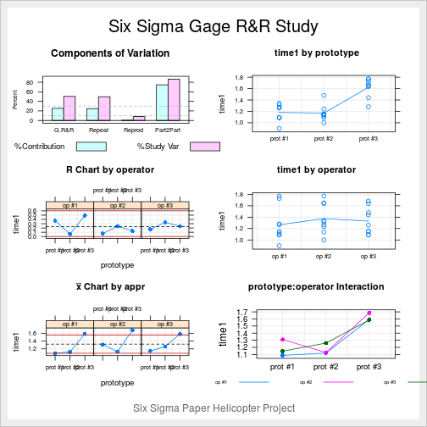
Six Sigma Demo R

Slide 24
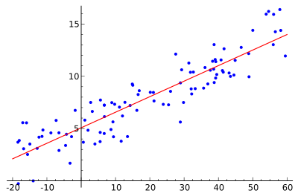
Six Sigma Demo in Python

Slide 25
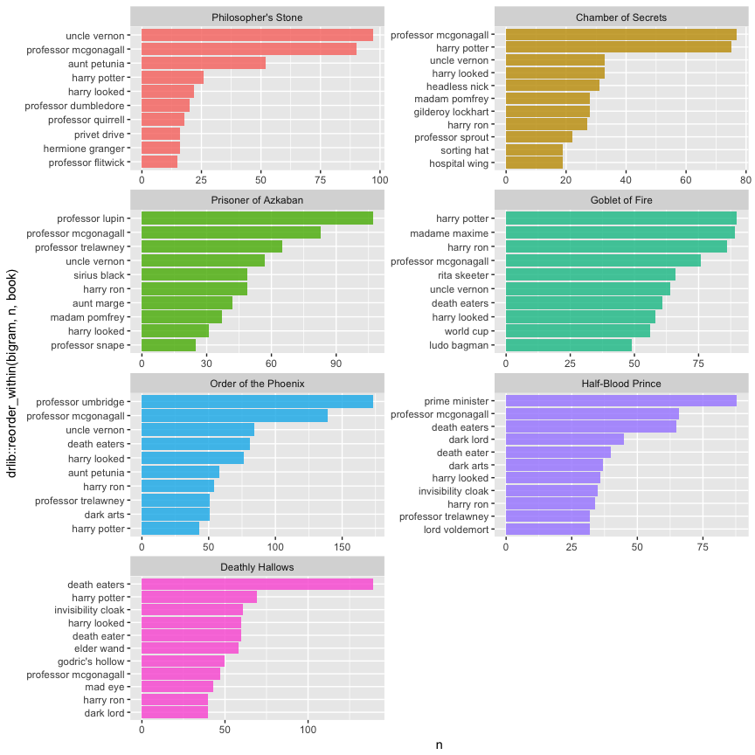
Text Analysis in R

Slide 26
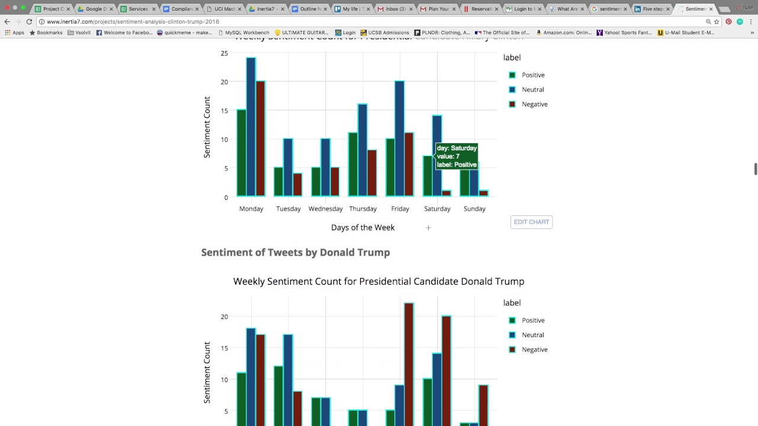
Sentiment Analysis in Python

Slide 27
Challenges
Output(ing)…as in stuff
Power…as in “I can actually hear my laptop struggling”
Learning curve…you gotta give a little
Updates

Slide 28
I wish…
I had learned the training/testing data trick sooner
I had found out about R sooner…every project is a data project
Someone would have helped me plan my training

Slide 29
Training Up
Coursera (http://www.coursera.org )
10 Course Certificate in Data Science
Many more data science courses
Free unless you want documentation
Udemy (http://www.udemy.com )
Data Science A to Z
Courses ~$10-25 dollars
edX (http://www.edx.org )
Also free unless you want documentation
SAP runs free courses
Learning R in Seven Simple Steps
http://www.datasciencecentral.com/profiles/blogs/learning-r-in-seven-simple-steps
http://www.datasciencecentral.com
http://www.kdnuggets.com

Slide 30
Q&A
What are your questions?

